Slide 1
Distributed Database Systems
Chapter 10
Introduction to Transaction Management

Slide 2
What is a transaction
Transaction is a sequence of database operations organized in a basic unit for keeping database consistent and reliable.

Slide 3
A database is in a consistent state if it follows:
Entity integrity
Referential integrity
Domain value constraints
etc.

Slide 4
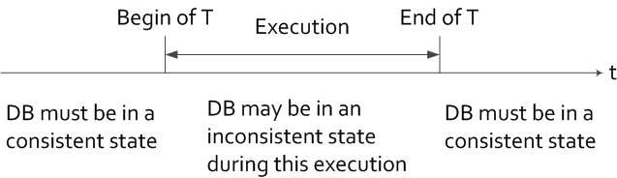
A temporary inconsistent state of a transaction should not be exposed to other transactions.
A database should be in a consistent state even if there are a number of concurrent transactions accessing the database.

Slide 5
What does reliability mean to DB
A database is reliable if it is resilient and capable of recovering.

Slide 6
A transaction is a sequence of read and write operations on a DB with some special properties (ACID).
An SQL statement is a transaction.
An embedded SQL statement is a transaction.
A program enclosed by “Begin-transaction” and “end” is a transaction.

Slide 7
Example: an airline DB
FLIGHT(FNO, DATE, SRC, DEST, STSOLD, CAP)
CUST(CNAME, ADDR, BAL)
FC(FNO, DATE, CNAME, SPETIAL)

Slide 8
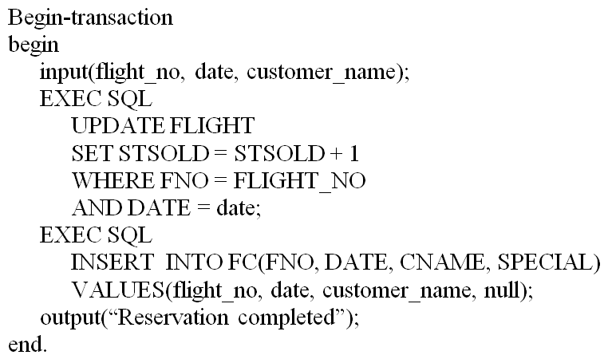
The reservation program

Slide 9
10.1.1 Termination Conditions of Transactions
A transaction may be terminated by command of
commit, i.e. successfully completed, or
rollback, i.e. aborted, and
no third choice

Slide 10
10.1.1 Termination Conditions of Transactions
Commit makes DB operations effect permanent and the result is visible to other transactions.
Rollback undoes all DB operations and restore the DB to the state before the execution of the transaction.

Slide 11
10.1.1 Termination Conditions of Transactions
Rewrite the previous example to cope with full reservation.
An Example of Transaction Program

Slide 12
10.1.2 Characterization of Transactions
Read Set (RS) – the set of data items that a transaction reads
Write Set (WS) – the set of data that a transaction writes
Base Set (B) – RS∪WS

Slide 13
10.1.3 Formalization of the Transaction Concept
-- operation
of transaction
on the database entity x, where
∈{read, write} and is atomic.
-- the set of all operations of
N_{i}∈{abort, commit} -- the termination of

Slide 14
10.1.3 Formalization of the Transaction Concept
A transaction T_{i} is a partial ordering over its operations and the termination condition, written as
, where
1.
2.
For any two operations
, if
and
for any x, then either
or
3.

Slide 15
10.1.3 Formalization of the Transaction Concept
Note
is an ordering relation for
database operations of T_{i} . Two operations are in conflict if one of them is a write.

Slide 16
Example 10.5
A transaction T consisting of operations
Read(x), Read(y), x←x+y, Write(x), Commit
∑ = {R(x), R(y), W(x), C}
= {(R(x),W(x)), (R(y),W(x)), (W(x),C), (R(x),C), (R(y),C)}

Slide 17
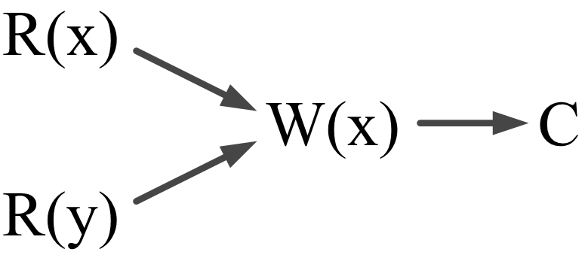
Example 10.5
A partial order can be represented by a DAG (Directed Acyclic Graph) whose vertices ate the operations and edges are ordering

Slide 18
Example 10.5
Note no order exists between R(x) and R(y)
A transaction can be simplified by using its relative order of operations, e.g. the above T can be written as
T = {R(x), R(y),W(x),C}

Slide 19
10.2 Properties of Transactions
10.2.1 Atomicity
“All-or-nothing” principle.

Slide 20
10.2.2 Consistency
The property to be guaranteed by concurrency control. Four levels of consistency can be defined on the basis of dirty data concept.
Dirty data – the data value that have been changed by a transaction prior to its commitment.

Slide 21
10.2.2 Consistency
Consistency degree Conditions | 3 | 2 | 1 | 0
A transaction T does not overwrite dirty data of other transactions. | √ | √ | √ | √
A transaction T does not commit any writes until it completes all writes, i.e. until the end of T. | √ | √ | √
T does not read dirty data from other transactions. | √ | √
Other transactions do not dirty any data read by T before T completes. | √

Slide 22
10.2.3 Isolation
An executing transaction cannot reveal its results to other concurrent transactions before its commitment.
Reasons for requiring isolation
(see next pages)

Slide 23
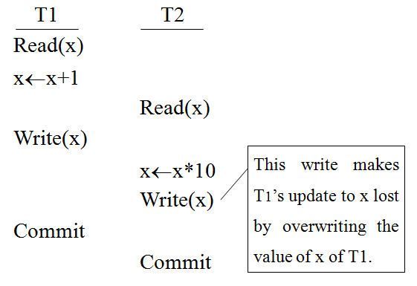
10.2.3 Isolation
Reasons for requiring isolation
Lost update caused by early release of x before commit

Slide 24
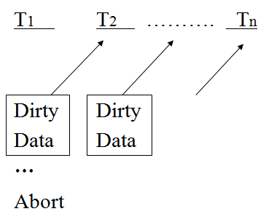
10.2.3 Isolation
Reasons for requiring isolation
Cascading abort
T_{i} reveals its data to T_{i+1} before commit, when T₁ aborts, all other transactions must abort.

Slide 25
10.2.3 Isolation
Consistency degree level 3 provides complete isolation.
Consistency degree level 2 avoids cascading aborts

Slide 26
Understand the concepts
脏读（Dirty read）
事务T1修改了一行数据，但是还没有提交，这时候事务T2读取了被事务T1修改后的数据，之后事务T1因为某种原因Rollback了，那么事务T2读取的数据就是脏的。
不可重复读（Unrepeatable read）
事务T1读取某一数据，事务T2读取并修改了该数据，T1为了对读取值进行检验而再次读取该数据，便得到了不同的结果。

Slide 27
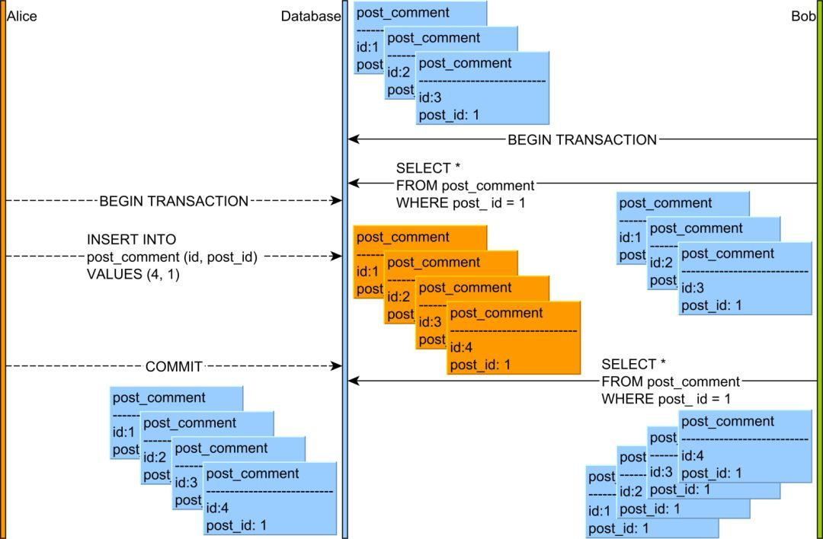
Understand the concepts

Slide 28
Understand the concepts
幻读（Phantom read）
系统管理员A将数据库中所有学生的成绩从具体分数改为ABCDE等级，但是系统管理员B就在这个时候插入了一条具体分数的记录，当系统管理员A改结束后发现还有一条记录没有改过来，就好像发生了幻觉一样。这就叫幻读。
在事务1中，查询User表id为1的是用户否存在，如果不存在则插入一条id为1的数据。在事务1查询结束后，事务2往User表中插入了一条id为1的数据。由于事务1查询到id为1的用户不存在，因此插入1条id为1的数据，结果报主键冲突错误

Slide 29
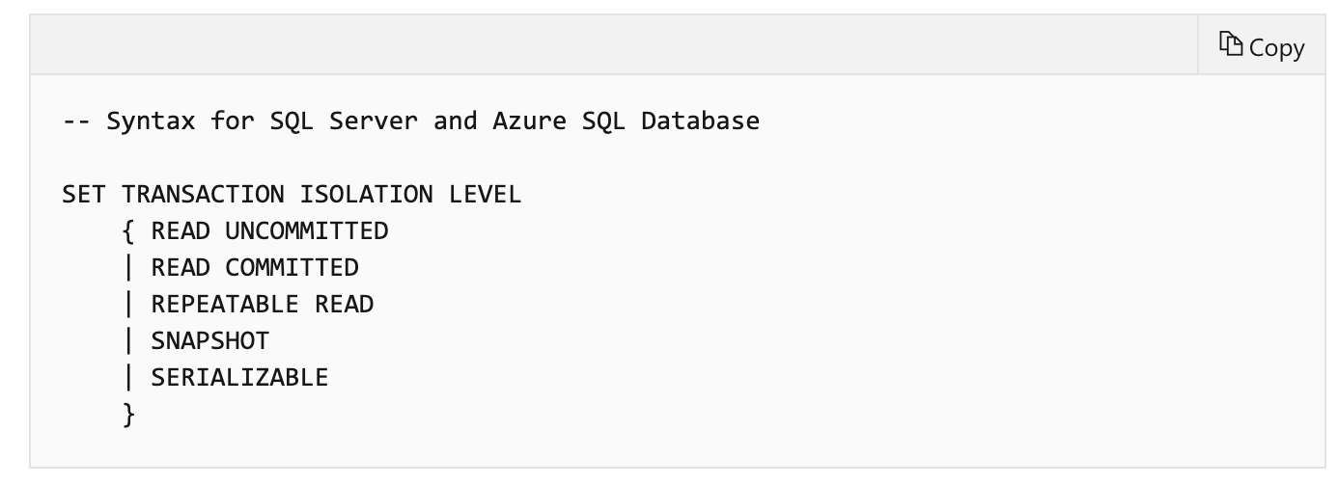
Transaction Isolation Level
READ UNCOMMITTED
READ COMMITTED
REPEATABLE READ
SNAPSHOT
SERIALIZABLE
https://docs.microsoft.com/en-us/sql/t-sql/statements/set-transaction-isolation-level-transact-sql?view=sql-server-ver15

Slide 30
思考题
请根据以下需求，设置隔离级别
避免脏读
避免脏读和不可重复读
避免幻读

Slide 31
10.2.4 Durability
Once a transaction commits, its results are permanent and will survive subsequent system failures.
Durability demands recovery functions of a DBMS.
(to be discussed later)

Slide 32
10.3 Types of Transactions
Classifications of transactions
By applications
Regular vs. Distributed
Compensating, if its purpose is to undo the effect of previous transactions
Heterogeneous, if the application runs in a heterogeneous DB

Slide 33
10.3 Types of Transactions
By duration
On-line or short-life transactions
Batch or long-life transactions
By structure
Traditional flat structure
Nested

Slide 34
10.3 Types of Transactions
Example of nested transactions:
Begin_transaction Reservation
Begin_transaction Airline
…
end. {Airline}
Begin_transaction Hotel
…
end. {Hotel}
end.

Slide 35
10.3 Types of Transactions
A subtransaction must begin after its parent and finish before its parent.
The commit/abort of a subtransaction depends on its parent.
Subtransaction within a parent may be executed in parallel.
Subtransactions may recover from failures independently.
We only deal with general, flat transactions in this course.

Slide 36
10.4 Architecture Revised
Expand the Distributed Execution Monitor (DEM) in Figure 4.7 on Page 85 to include two modules: a transaction monitor (TM) and a scheduler (SC).
TM: coordinate the execution of DB operations on behalf of an application.
SC: implement a specific concurrency control algorithm to synchronize accesses to DB.

Slide 37
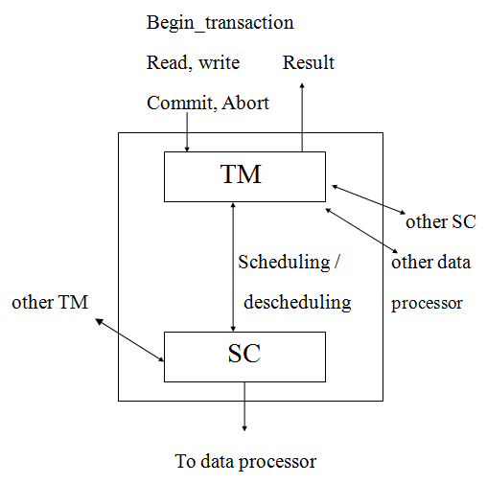
10.4 Architecture Revised for DEM
This model is NOT unique

Slide 38
Conclusion
Transaction is a unit of consistent and reliable access to the database
Transaction has the ACID property
A and D are enforced by reliability (Chapter 12)
C and I are enforced by concurrency control (Chapter 11)

